Slide 1
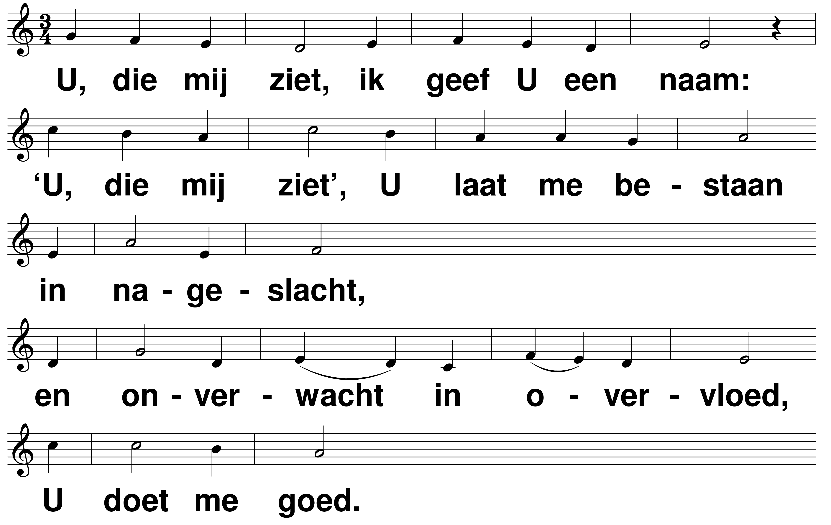
Hagar t: Robert Roth m: Henk Vogel

Slide 2
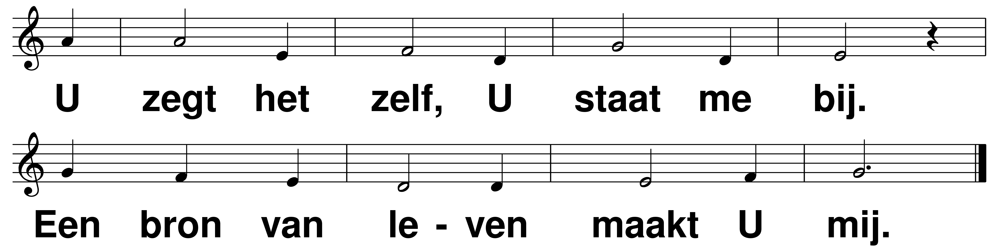
Hagar t: Robert Roth m: Henk Vogel

Slide 3
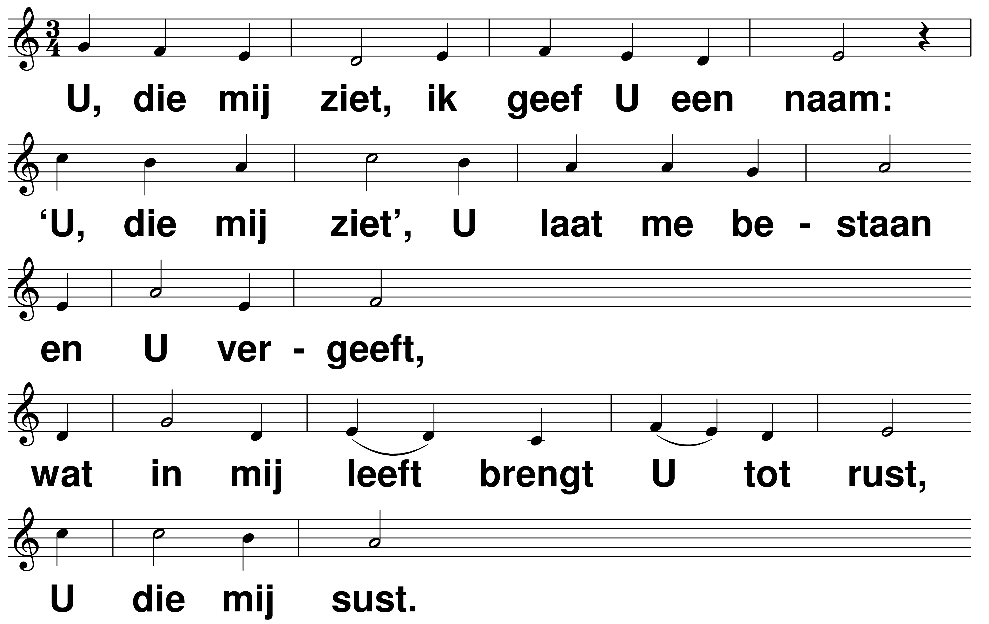
Hagar t: Robert Roth m: Henk Vogel

Slide 4
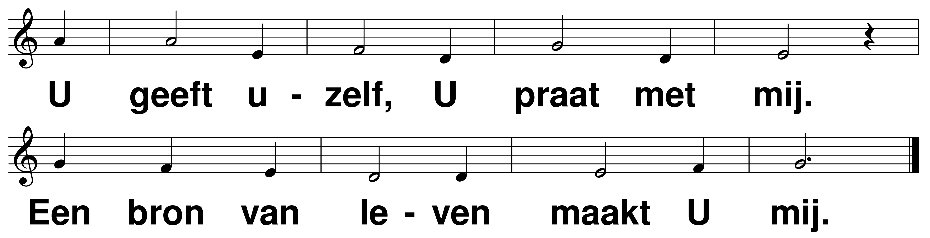
Hagar t: Robert Roth m: Henk Vogel

Slide 5
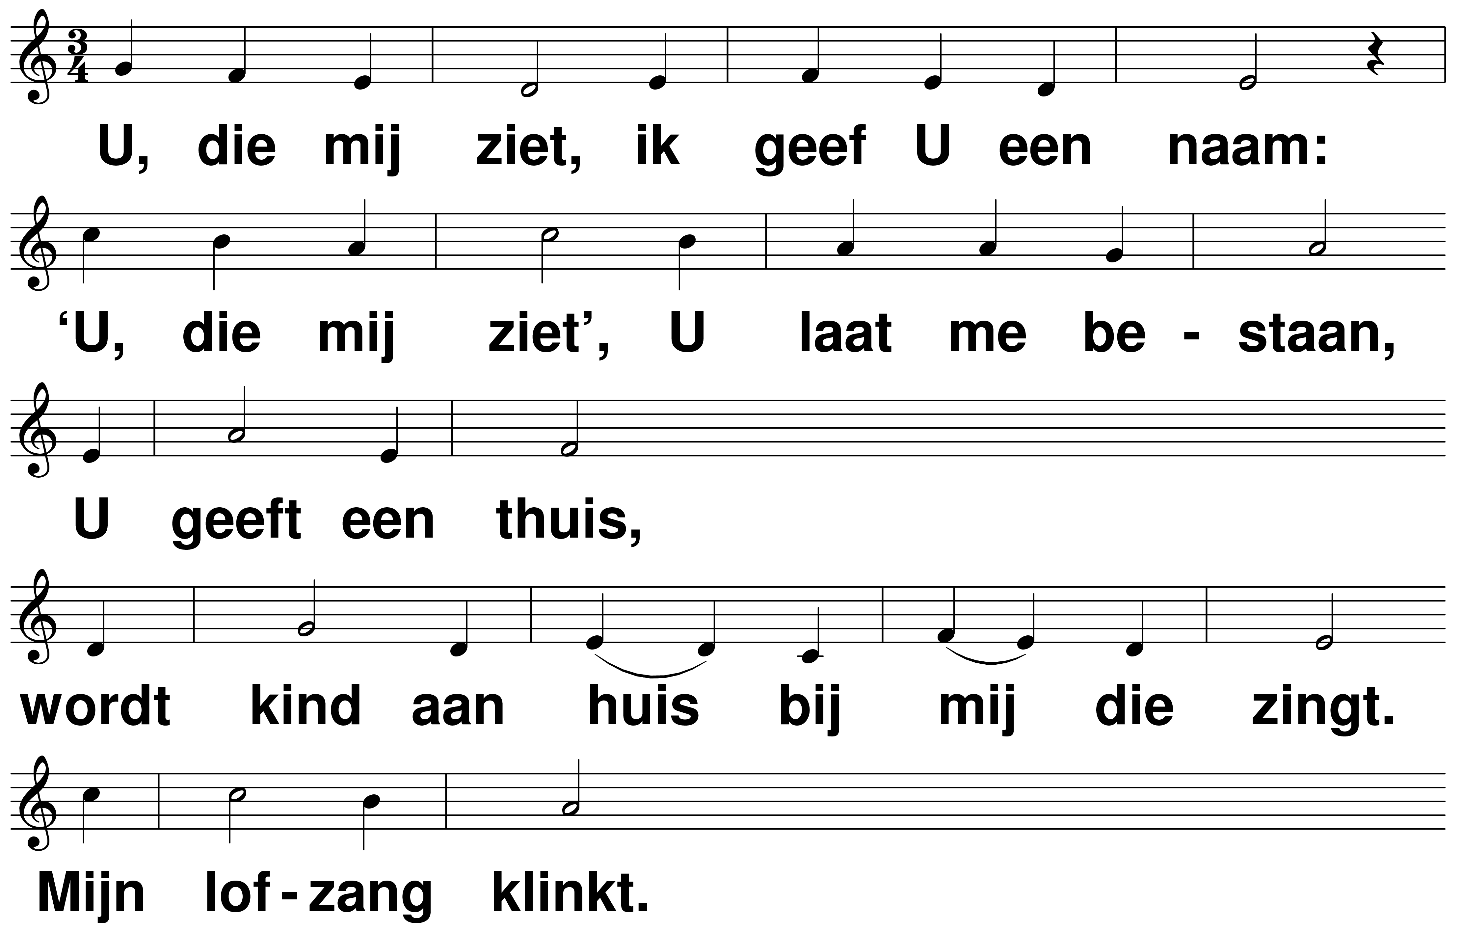
Hagar t: Robert Roth m: Henk Vogel

Slide 6
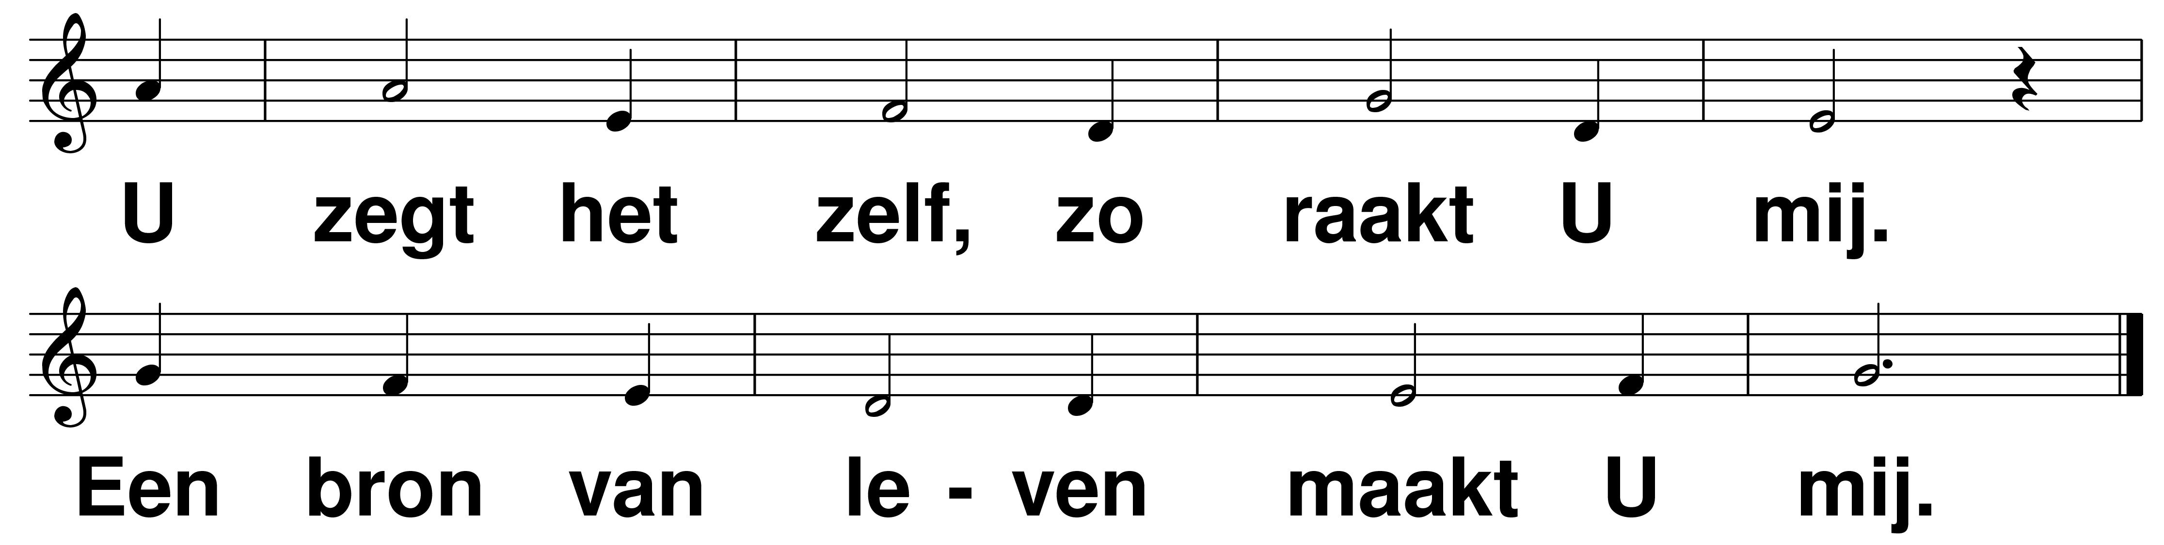
Hagar t: Robert Roth m: Henk Vogel

